Slide 1
Signals and Communication Systems
AM and FM Transmitter and Receiver

Slide 2
AM Receiver Characteristics

Slide 3
Receiver Parameters
Sensitivity
Selectivity
Dynamic Range
Stability
Fidelity

Slide 4
Receiver Parameters
Sensitivity
Ability to recover weak signals and process them into readable data.
The most common way to express receiver sensitivity is to state the number of ac signal (micro volts) at the antenna, needed to produce a given signal-to-noise (S/N) ratio.
Selectivity
Ability of a receiver to respond to a desired signal but not undesired ones

Slide 5
Receiver Parameters
Dynamic Range
ability of a receiver to maintain a fairly constant output and to keep its sensitivity—in the presence of signals ranging from the very weak to the extremely strong.
expressed in dB and is typically over 100 dB
Stability
The ability to remain tuned to a station once it has
been set
Fidelity
The ability to preserve the exact shape of the information

Slide 6
Carrier Frequency Requirements in a Radio Transmitter
Generated carrier frequency must be exactly at the specified value. The carrier frequency is determined by the master oscillator frequency.
Carrier frequency should be readily adjustable.
Frequency drift and frequency scintillation should be extremely small.

Slide 7
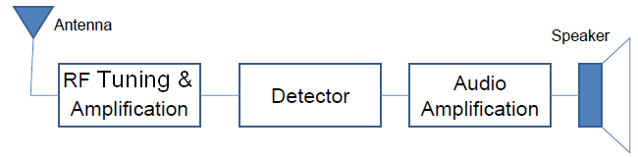
Tuned Radio Frequency Receiver
TRF receivers were the first radio receivers for
broadcast AM
These receivers generally had three stages of RF amplification
Each RF amplification stage was preceded by a separate variable-tuned circuit

Slide 8
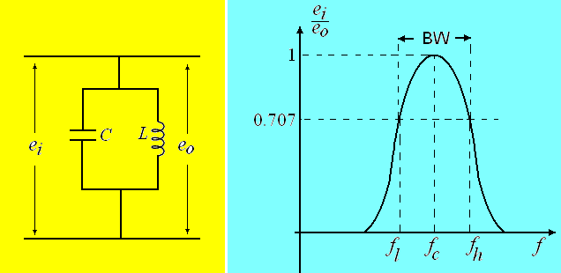
Tuned Radio Frequency Receiver
All three tuned are carefully adjusted to receive a required station.

Slide 9
Advantages and Limitations
Advantages:
No frequency conversion
Simple circuit
Limitations:
Variation of BW over the tuning range
Difficult to design tunable RF stages
Insufficient adjacent-frequency rejection
Difficult to obtain high gain RF amplifiers
It is not often used.

Slide 10
End

